Slide 1
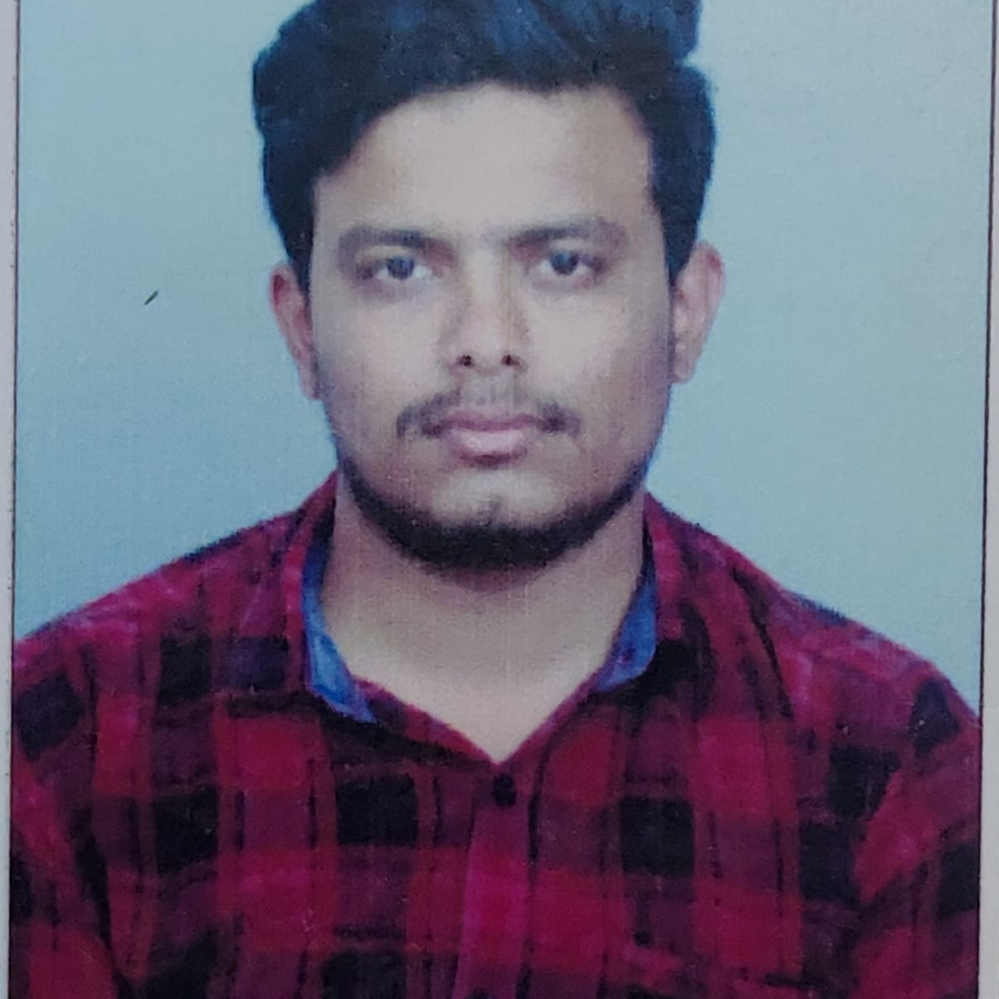

PRAJWAL KASAR
Analyst/Software Engineer
Bachelor of Engineering
COMPUTER SCIENCE:2017-2021
Skills
Mumbai
C | C Basics, OOPS, Generics, Collections, Arrays, Loops , Data Types in C ;
UI Framework-React | Fundamentals components ,Java Script, Working with states & props in React , Event Handling in React , Routing ,Life Cycle Method, Working with HTTP in React.
React | Components, Services, Modules, Routing, Forms & Validation.
Database | MONGO DB(MONGO BASH, MONGO COMPASS)
UI Tech | HTML 5 & CSS 3,JavaScript, Optimized UI Designed
Tools | IntelliJ Idea, Visual Studio code, Swagger, Postman, JACOCO, J-unit and Mockito.
Add On skills | Communications, Team management. Peer learning
Prajwal.prashant-kasar@capgemini.com
+91 9901629788
A4
Proficient in C ,JAVA and OOPs concepts.
Hands on experience in creating Spring boot Application with Rest API, React.
Hands on experience in developing web pages using HTML5, CSS3, Object Oriented Programming, JSON, XML .
Practical understanding of rendering REST API.
Proficient React developer with working knowledge on React.
Implemented Rest API and React in case study and up skilling this knowledge continuously.
Implemented the Database model with MongoDB.
DEALS AND COUPONS FINDER APP
Working on end to end case study of DEALS AND COUPONS FINDER Application along with authentication, Swagger and React used for user interface.
Spring boot and React for web developers in Degreed Platform
Completed this course with optimal Knowledge of MongoDB ,REST API , RESTful services , Components.

